Slide 1
2.3.2 Vector addition

Slide 2
Introduction
In this topic, we will
Describe the operation of vector addition
First look at real vector addition
Next look at complex vector addition
Discuss some properties

Slide 3
Real vector addition
Given two vector in R^{n}, we can add the corresponding entries
This is usually written as u + v
For example, if and ,
then

Slide 4
Real vector addition
We may also just write

Slide 5
Real vector addition
Note that,
Also, if ,

Slide 6
Real vector addition
Also note that

Slide 7
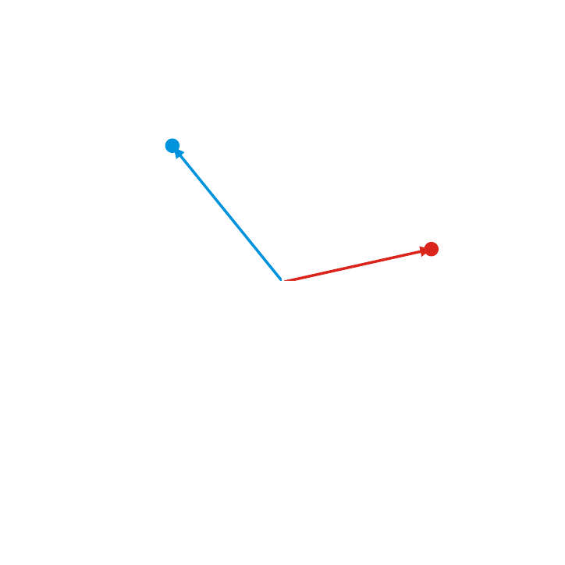
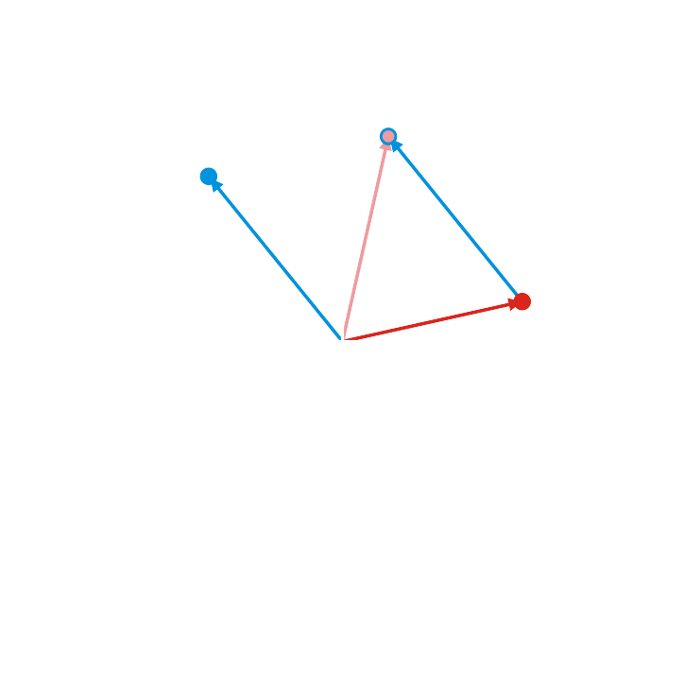
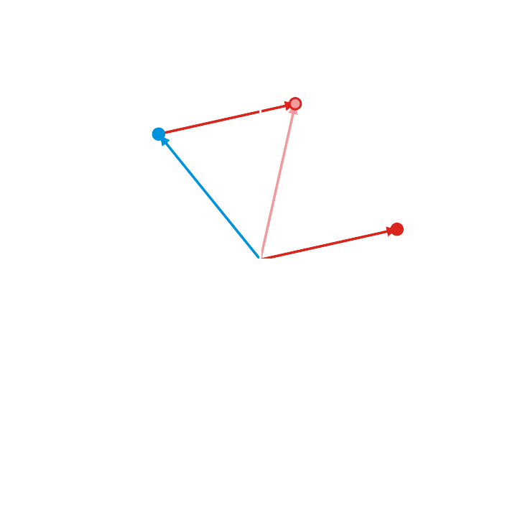
Geometric interpretation
In two dimensions (R²), if vectors are interpreted as arrows from the origin,
the sum of two vectors is equivalent to placing the base of one vector at the head of the other

Slide 8
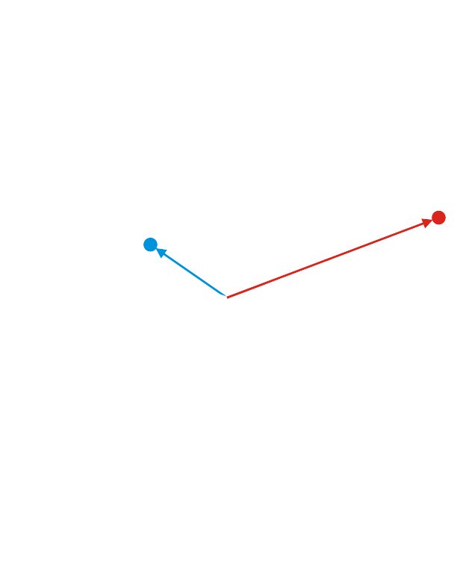
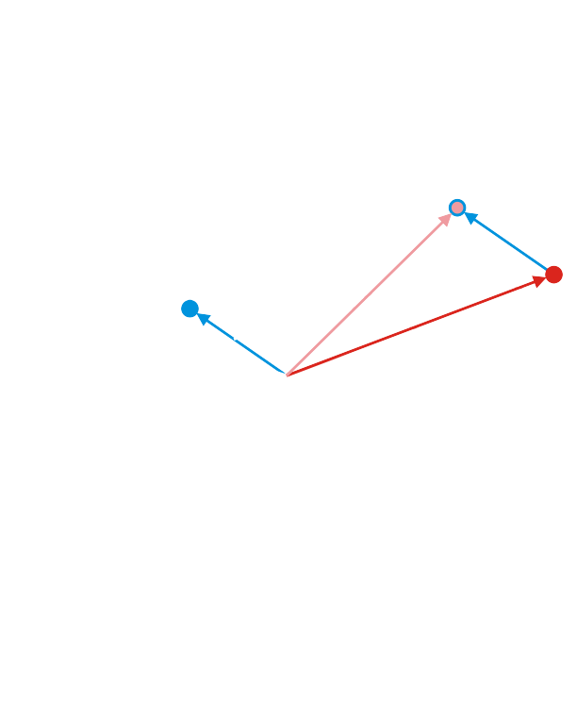
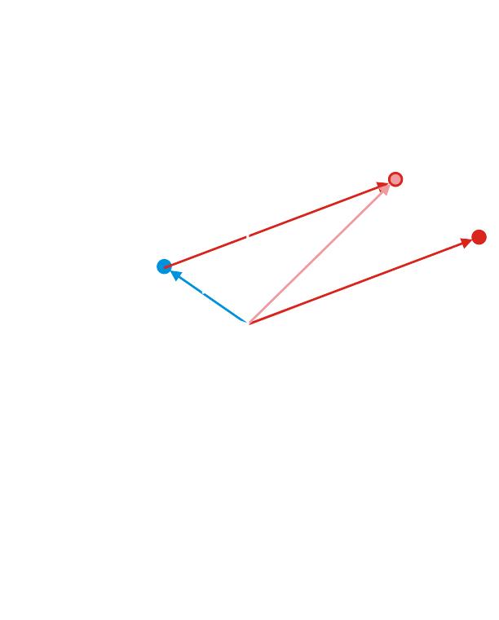
Geometric interpretation
A similar interpretation is appropriate for 3-d vectors

Slide 9
Complex vector addition
Given two vector in C^{n}, we can add them in a similar manner:
For example, if and
then

Slide 10
Complex vector addition
Note that if , then it is still true that
and
Also, we expect that u + v = v + u and (u + v) + w = u + (v + w)

Slide 11
Observations
Note that:
Adding two n-dimensional vectors results in an n-dimensional vector
We are either dealing with real vectors or complex vectors
There is no point in asking “What happens if you add a real vector to a complex vector?”
It’s like asking “What happens if you start with five cups of water and someone gives you 1 + 2j more cups?”
Similarly, we only add vectors of the same dimension
Adding a thousand-dimensional vector to a 2-dimensional vector is meaningless
You may be able to interpret a 2-d vector as a 3-d vector,
and then add that 3-d vector onto another 3-d vector

Slide 12
Summary
Following this topic, you now
Understand the concept of vector addition
Have seen examples for both real and complex numbers
Looked at how vector addition interacts with the zero vector
Looked at some properties and made some observations

Slide 13
References
[1] https://en.wikipedia.org/wiki/Scalar_multiplication

Slide 14
Acknowledgments
None so far.

Slide 15
Colophon
These slides were prepared using the Cambria typeface. Mathematical equations use Times New Roman, and source code is presented using Consolas.
The photographs of flowers and a monarch butter appearing on the title slide and accenting the top of each other slide were taken at the Royal Botanical Gardens in October of 2017 by Douglas Wilhelm Harder. Please see
https://www.rbg.ca/
for more information.

Slide 16
Disclaimer
These slides are provided for the ne 112 Linear algebra for nanotechnology engineering course taught at the University of Waterloo. The material in it reflects the authors’ best judgment in light of the information available to them at the time of preparation. Any reliance on these course slides by any party for any other purpose are the responsibility of such parties. The authors accept no responsibility for damages, if any, suffered by any party as a result of decisions made or actions based on these course slides for any other purpose than that for which it was intended.

